Slide 1
Skating Merit Badge Roller Skating Option
Troop 344 and 9344
Pemberville, OH

Slide 2
Internet access is necessary for viewing the online tutorials of the various skating skills.
If you are a Scout, please obtain parental permission before viewing the videos.

Slide 3
Skating Merit Badge Requirements
Do the following:
Explain to your counselor the most likely hazards associated with skating and what you should do to anticipate, help prevent, mitigate, and respond to these hazards.
Show that you know first aid for injuries or illnesses that could occur while skating, including hypothermia, frostbite, lacerations, abrasions, fractures, sprains and strains, blisters, heat-related reactions, and shock.

Slide 4
Skating Merit Badge Requirements
Complete ALL of the requirements for ONE of the following options,
Roller Skating
Do the following:
Give general safety and etiquette rules for roller skating.
Discuss the parts and functions of the roller skate.
Describe five essential steps to good skate care.
Do the following:
Skate forward with smooth, linked strokes on two feet for at least 100 feet in both directions around the rink and demonstrate proper techniques for stopping.
Skate forward and glide at least 15 feet on one skate, then on the other skate.

Slide 5
Skating Merit Badge Requirements
Complete ALL of the requirements for ONE of the following options,
Roller Skating
Do the following:
Perform the crossover.
Skate backward for at least 40 feet on two skates, then for at least 15 feet on one skate.
Skate forward in a slalom pattern for at least 40 feet on two skates, then for at least 20 feet on one skate.
Skate backward in a slalom pattern for at least 15 feet on two skates.

Slide 6
Skating Merit Badge Requirements
Complete ALL of the requirements for ONE of the following options,
Roller Skating
Do the following:
Shuttle skate once around the rink, bending twice along the way without stopping.
Perform a series of two consecutive spins on skates, OR hop, skip, and jump on skates for at least 10 feet.

Slide 7
Skating Merit Badge Requirements
Complete ALL of the requirements for ONE of the following options,
Roller Skating
Do the following:
Race on a speed track, demonstrating proper technique in starting, cornering, passing, and pacing.
Perform the limbo under a pole placed at least chest-high OR shoot-the-duck under a waist-high pole and rise while still on one foot.
Perform the stepover.
While skating, dribble a basketball the length of the floor, then return to your starting position, OR push a hockey ball with a stick around the entire rink in both directions.

Slide 8
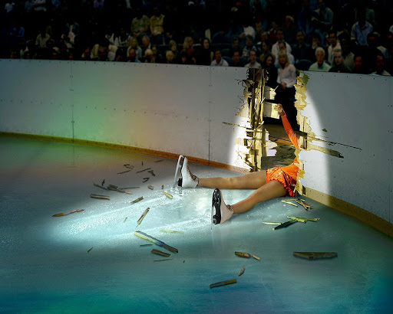
Requirement 1a
Explain to your counselor the most likely hazards associated with skating and what you should do to anticipate, help prevent, mitigate, and respond to these hazards.

Slide 9
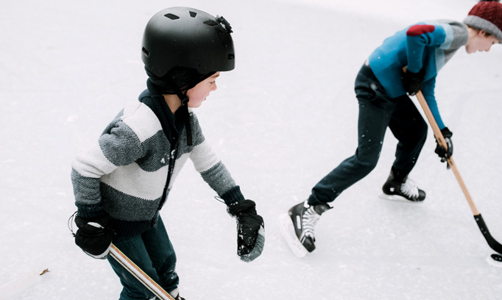
Hazards of Skating
Ankle Sprains & Fractures The intense weight and pressure placed upon the ankles during skating activity makes them susceptible to sprains and fractures.
Head Injuries When a loss of balance or control occurs, head injuries are a common and serious consequence. The ice surface is very dangerous as there is no cushion against impact. These skating injuries may include concussions or other traumatic brain injuries. Wear a helmet!

Slide 10
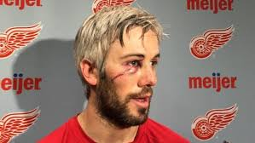
Hazards of Skating (continued)
ACL Tears The anterior cruciate ligament (ACL) runs diagonally through the middle of the knee and provides rotational stability. A traumatic injury, such as those commonly sustained during ice skating, can cause a tear of the ACL or surrounding menisci.
Lacerations Sharp blades. Hard ice. Speed and precise movements. These combined factors put ice skaters at risk of lacerations of varying degrees of severity.

Slide 11
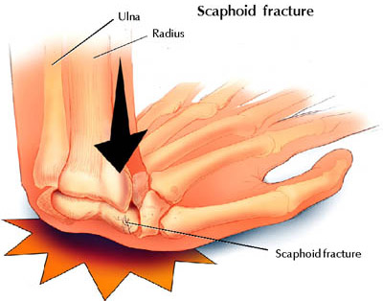
Hazards of Skating (continued)
Hand and Wrist Injuries When we experience a slip or fall, our immediate instinct is to put our hands out to catch ourselves--which is good, because it protects the more important head and face. But it can also result in serious injury to the hand or wrist from the force of the impact.

Slide 12
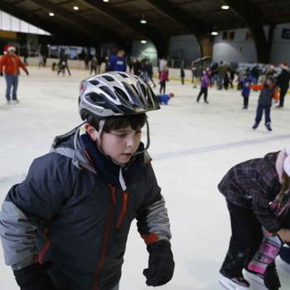
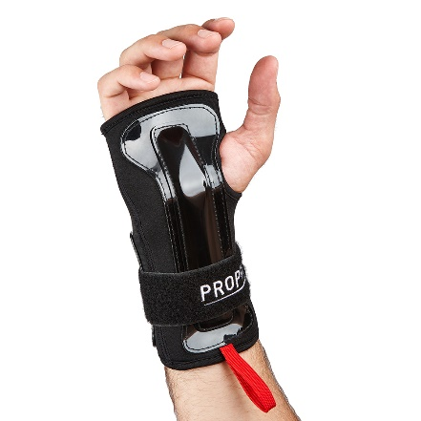
Skating Safety Tips
Proper Equipment Many of the orthopedic skating injuries that are commonly suffered can be prevented by simply wearing proper equipment; that may include padding, helmets, and--of course--quality skates.
Proper Fit Skates that do not fit properly contribute to a high number of skating injuries; they may cause stress to bones, muscles, and ligaments, as well as imbalance.

Slide 13
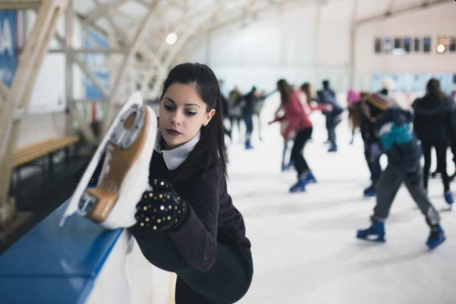
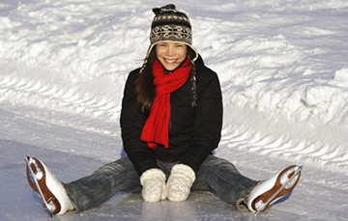
Skating Safety Tips (continued)
Warm Up Thoroughly Cold muscles and ligaments are more brittle and prone to tears and injury. Warming up can help to loosen your muscles, tendons, and ligaments and help to prevent tears.
Avoid Extreme Exposure Wear adequately warm clothing--thick layers and a waterproof shell. And pay attention to changing weather. If you start to feel uncomfortable or chilled, it’s time to end your activity and return to warm shelter.

Slide 14
Requirement 1b
Show that you know first aid for injuries or illnesses that could occur while skating, including hypothermia, frostbite, lacerations, abrasions, fractures, sprains and strains, blisters, heat-related reactions, and shock.

Slide 15
First Aid for Hypothermia
Gently remove wet clothing.
Replace wet things with warm, dry coats or blankets.
If further warming is needed, do so gradually.
For example, apply warm, dry compresses to the center of the body — neck, chest and groin.

Slide 16
First Aid for Frostbite
Warm the frostbitten parts in warm (not hot) water for about 30 minutes.
Place clean cotton balls between frostbitten fingers and toes after they've been warmed.
Loosely wrap warmed areas with clean bandages to prevent refreezing.
Give acetaminophen or ibuprofen for pain.

Slide 17
First Aid for Lacerations
Stop the Bleeding by apply direct pressure on the area if necessary.
Clean the area with warm water and gentle soap.
Apply an antibiotic ointment to reduce chance of infection.
For a minor laceration, remove the bandage after a couple of days to promote healing.
Call a health care provider if:
The cut is deep or over a joint
If the cut doesn't heal or shows signs of infection, including redness, swelling, pus, or excessive pain.

Slide 18
First Aid for Abrasions
Gently clean the area with cool to lukewarm water and mild soap.
Remove dirt or other particles from the wound using sterilized tweezers.
Apply an antibiotic ointment to reduce chance of infection.
Cover it with a clean bandage or gauze.
Gently clean the wound and change the ointment and bandage once per day.
Watch the area for signs of infection, like pain or redness and swelling.
See your doctor if you suspect infection.

Slide 19
First Aid for Fractures
Stop any bleeding: If they’re bleeding, elevate and apply pressure to the wound using a sterile bandage, a clean cloth, or a clean piece of clothing.
Immobilize the injured area: If you suspect they’ve broken a bone in their neck or back, help them stay as still as possible. If you suspect they’ve broken a bone in one of their limbs, immobilize the area using a splint or sling.
Apply cold to the area: Wrap an ice pack or bag of ice cubes in a piece of cloth and apply it to the injured area for up to 10 minutes at a time.
Treat them for shock: Help them get into a comfortable position, encourage them to rest, and reassure them. Cover them with a blanket or clothing to keep them warm.
Get professional help: Call 911 or help them get to the emergency department for professional care.

Slide 20
First Aid for Sprains and Strains
Rest the sprained or strained area. If necessary, use a sling for an arm injury or crutches for a leg or foot injury. Splint an injured finger or toe by taping it to an adjacent finger or toe.
Ice for 20 minutes every hour. Never put ice directly against the skin or it may damage the skin. Use a thin towel for protection.
Compress by wrapping an elastic (Ace) bandage or sleeve lightly (not tightly) around the joint or limb. Specialized braces, such as for the ankle, can work better than an elastic bandage for removing the swelling.
Elevate the area above heart level if possible.
Manage pain and inflammation with ibuprofen or acetaminophen
All but the most minor strains and sprains should be evaluated by a doctor.

Slide 21
First Aid for Blisters
If a blister isn't too painful, try to keep it intact.
Unbroken skin over a blister may provide a natural barrier to bacteria and decreases the risk of infection.
Cover it with an adhesive bandage or moleskin.

Slide 22
First Aid for Blisters
To relieve blister-related pain, drain the fluid while leaving the overlying skin intact.
Wash your hands and the blister with soap and warm water.
Swab the blister with iodine.
Sterilize a clean, sharp needle by wiping it with rubbing alcohol.
Use the needle to puncture the blister. Aim for several spots near the blister's edge. Let the fluid drain, but leave the overlying skin in place.
Apply an antibiotic ointment to the blister and cover it with a nonstick gauze bandage.
Follow-up care. Check the area every day for infection. Apply more ointment and a bandage.

Slide 23
Symptoms of Heat Reactions

Slide 24
First Aid for Heat Related Reactions
For Heat Exhaustion:
Move the person out of the heat and into a shady or air-conditioned place.
Lay the person down and elevate the legs and feet slightly.
Remove tight or heavy clothing.
Have the person drink cool water or other nonalcoholic beverage without caffeine.
Cool the person by spraying or sponging with cool water and fanning.
Monitor the person carefully.
Contact a doctor if signs or symptoms worsen or if they don't improve within one hour.

Slide 25
Symptoms of Shock

Slide 26
First Aid for Shock
Lay the person down and elevate the legs and feet slightly, unless you think this may cause pain or further injury.
Keep the person still and don't move him or her unless necessary.
Turn the victim’s head to one side if neck injury is not suspected.
Begin CPR if the person shows no signs of life, such as not breathing, coughing or moving.

Slide 27
Requirement 2a Roller Skating
Do the following:
Give general safety and etiquette rules for roller skating.
Discuss the parts and functions of the roller skate.
Describe five essential steps to good skate care.

Slide 28
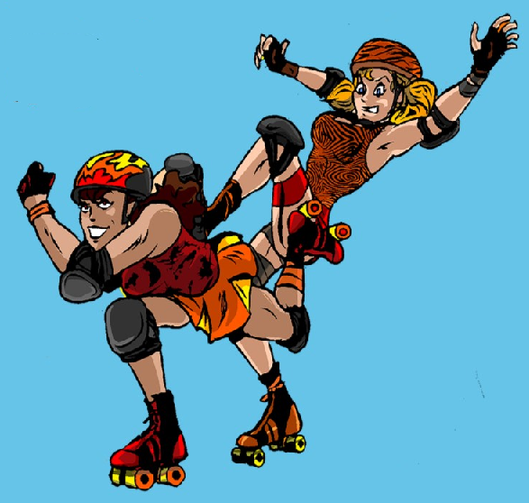
Safety Rules and Etiquette for Roller Skating
Be friendly and helpful to other skaters, especially to younger children.
No speed skating during public skating sessions. Any skater who consistently passes more skaters than pass him/her is skating too fast.
No tag, follow-the-leader, or crack-the-whip.
No roughhousing.
No eating or drinking on the skating surface

Slide 29
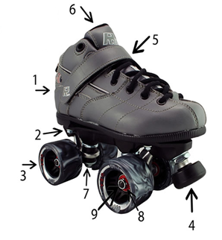
Parts and Functions of Roller Skates
The Parts of a Roller Skate
Every skate has a boot that is made of leather or man-made materials.
The plate is the part of the skate that attaches the boot to the trucks and skate wheels.
Wheels come in many different sizes, styles, and grip or hardness levels.
Toe stops allow you to elevate off of your wheels and onto a stable, flat surface.
Velcro speed straps are used to secure a tighter fit than just laces can do.
The tongue of a skate boot allows for adjustable lacing and may have more or less padding depending on the type of skate.
The truck of a roller skate is the piece of metal that the wheel axle passes through. The trucks attach to the plate and hold the wheels. .
Bearings are what allow roller skates to turn, spin, and rotate on the axle of the wheel.
Axle nuts secure your wheels onto your truck.

Slide 30
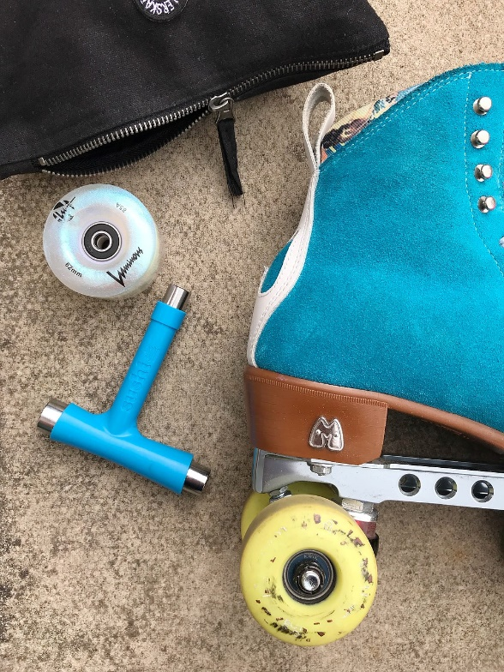
Roller Skate Care
No skate should ever be used before it is lubricated.
Use a leather softener and preserver on your boots of every 6 months
When removing your skates, unlace them until they slip off easily.
Put laces inside the boot for storage.
Before you skate, make sure all nuts are on tight.
Do not let toe stops wear down to the point where the metal parts cut up the floor.

Slide 31
Requirement 2b Roller Skating
Do the following:
Skate forward with smooth, linked strokes on two feet for at least 100 feet in both directions around the rink and demonstrate proper techniques for stopping.
Skate forward and glide at least 15 feet on one skate, then on the other skate.

Slide 32
Forward Skating
Click image for video

Slide 33
Stopping
Click image for video

Slide 34
Requirement 2c Roller Skating
Do the following:
Perform the crosscut.
Skate backward for at least 40 feet on two skates, then for at least 15 feet on one skate.
Skate forward in a slalom pattern for at least 40 feet on two skates, then for at least 20 feet on one skate.
Skate backward in a slalom pattern for at least 15 feet on two skates.

Slide 35
Crosscut
Click image for video

Slide 36
Skating Backwards
Click image for video

Slide 37
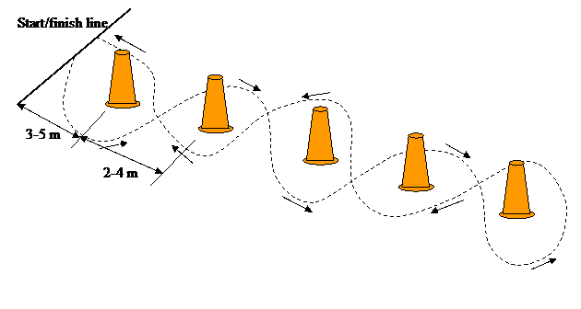
Slalom Skating
The illustration shows how to skate the slalom pattern.
This is a serpentine movement, following a course that is laid out on the skating surface

Slide 38
Requirement 2d Roller Skating
Do the following:
Shuttle skate once around the rink, bending twice along the way without stopping.
Perform a spread eagle.
Perform a Mohawk.
Perform a series of two consecutive spins on skates, OR hop, skip, and jump on skates for at least 10 feet.

Slide 39
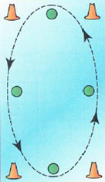
Shuttle Skating
In this test of skill, you skate at varying speeds around the rink and maintain balance while bending over to pick up an object from the rink floor.
Four blocks or similar objects are placed on the rink surface, one at each corner.
Four containers are spaced at equal distances away from the blocks.
You must skate around the rink and pick up each block and deposit it in the next container.

Slide 40
Spread Eagle
Click image for video

Slide 41
Mohawk
Click image for video

Slide 42
Spins
Click image for video

Slide 43
Hops
Click image for video

Slide 44
Jumps
Click image for video

Slide 45
Requirement 2e Roller Skating
Do the following:
Race on a speed track, demonstrating proper technique in starting, cornering, passing, and pacing.
Perform the limbo under a pole placed at least chest-high OR shoot-the-duck under a waist-high pole and rise while still on one foot.
Perform the stepover.
While skating, dribble a basketball the length of the floor, then return to your starting position, OR push a hockey ball with a stick around the entire rink in both directions.

Slide 46
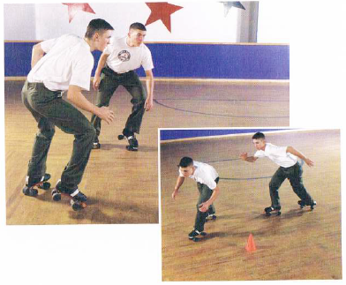
Racing
Racing should be done only under highly controlled conditions.
Speed skating and racing are generally done in rinks at times set aside for that purpose only.
Starting and cornering are shown in the photo to the right.

Slide 47
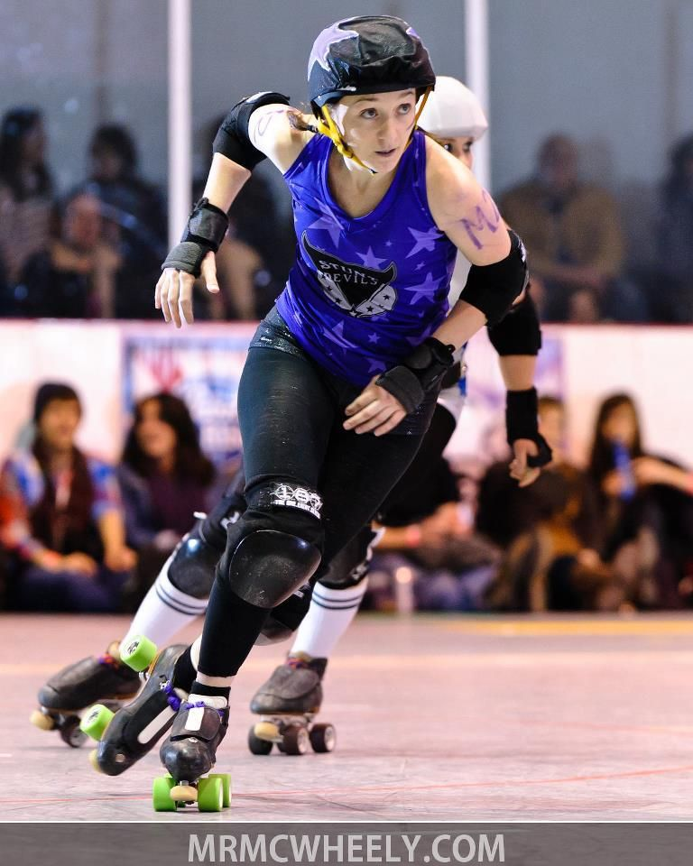
Racing
There are no “lanes” in roller speed races. All races begin with a standing start, and the number of competitors on the line for each race or heat varies, depending on the size of the track and the type of race being skated. The fastest time wins the race as his/her front wheels cross the finish line.
Some of the important rules that apply above all others include that athletes may be disqualified for blocking, pushing, holding, or hindering in any way the progress of another skater.
Passing a skater to the inside or outside must be completed without hindering the other skater. You should do your best to have completed a pass before entering the corner!
Skaters tend to form packs or "pacelines", in which skaters line up behind a lead skater and match their stride (pace), thereby saving energy by skating in their draft.
During the course of a race, skaters may make "attacks", speeding up the pace in an effort to weed out the weaker and slower competition.

Slide 48
The Limbo

Slide 49
Shoot-the-Duck
Click image for video

Slide 50
Stepover/Crossover
Click image for video

Slide 51
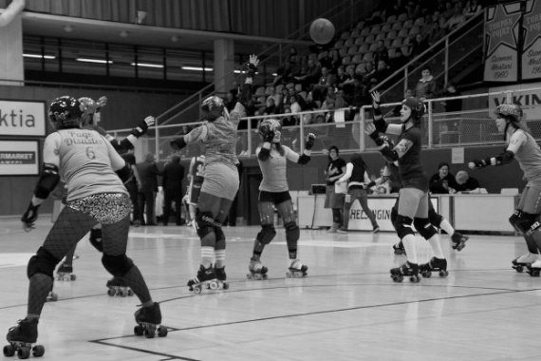
Basketball/Hockey Maneuvers
Dribble a basketball the length of the floor, then return to your starting position, OR push a hockey ball with a stick around the entire rink in both directions.

